Slide 1
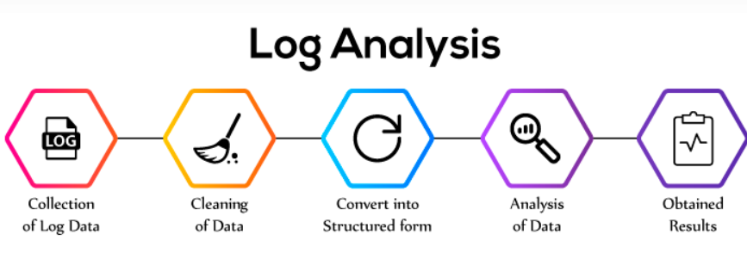
Log File Analysis & Reporting System
A Command-Line Tool for Parsing and Analyzing Web Server Logs.
TRAINER: NIKHIL SHARMA
DONE BY: Rajalakshmi S

Slide 2
PROBLEM STATEMENT
Design and develop a command-line interface (CLI) tool that can ingest, process, and analyze web server log files.
The tool must:
Read large log files (e.g., Apache Common Log Format)
Extract structured data from each entry using regex
Store the data in a normalized MySQL database
Provide commands to generate analytical reports about:
Web traffic
User behavior
Server performance

Slide 3
PROJECT OVERVIEW
Developed a command-line application that processes web server log files (e.g., Apache Common Log Format), parses relevant information, stores it in a MySQL database, and generates various analytical reports to understand web traffic patterns.
This project simulates a core data engineering task: ingesting and analyzing semi-structured operational data.
OBJECTIVES:
Parse web server logs (Apache format)
Store cleaned data in a MySQL database
Generate detailed analysis and reports

Slide 4
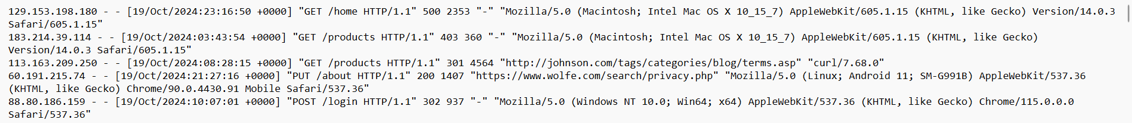
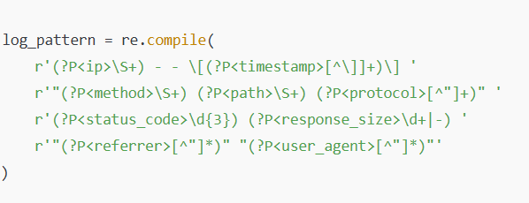
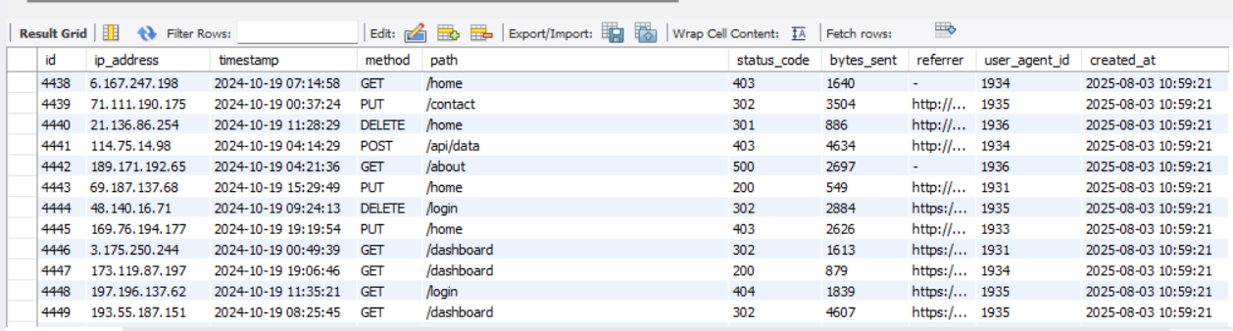
METHODOLOGY
DATA COLLECTION
Collected web server log files in Apache Common Log Format (CLF). Each log file contains—-> IP Address, Date and Time, Request type and Page URL , HTTPS status code , User agent string(Browser/info).
DATA CLEANING
Removed empty lines and malformed entries
Used regular expressions (regex) to extract key fields
Handled missing/unknown values(e.g., "unknown")
Data Transformation
Converted timestamps to MySQL-friendly DATETIME format
Extracted browser and OS info from user-agent strings
Mapped raw data into structured fields: status_code, requested_url, ip_address, etc.

Slide 5
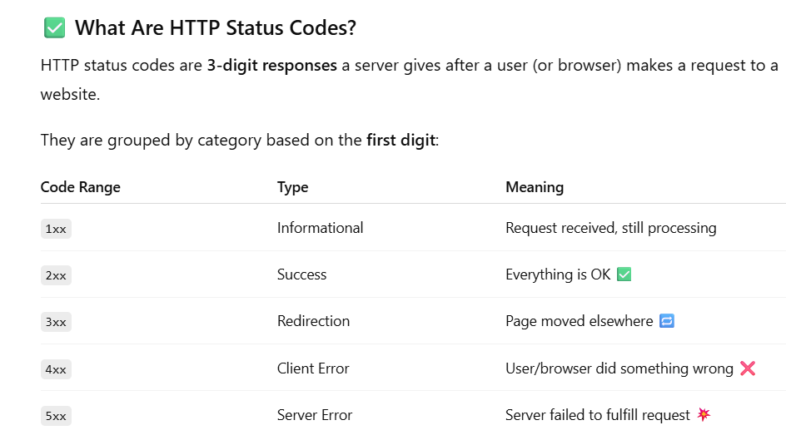
METHODOLOGY
Data Loading (ELT)
Connect to a MySQL database and Create database tables programmatically (DDL).
Efficiently insert parsed and transformed log entries into the MySQL database.Implement strategies for handling large log files (e.g., batch inserts, handling millions of rows).
Ensure idempotency for re-processing log files (avoid duplicate inserts if the same file is processed again).
CLI Interface & Reporting
Develop a comprehensive CLI using argparse or Click.
Available Commands:
process_logs <file_path>: Parses and loads logs from a specified file.
tail_logs <file_path> (Bonus): Monitors a log file continuously for new entries.
generate_report <report_type> [options]: Generates various reports.

Slide 6
METHODOLOGY
Report Types:
top_n_ips <n>: Top N requesting IP addresses.
status_code_distribution: Breakdown of HTTP status codes (2xx, 3xx, 4xx, 5xx).
hourly_traffic: Request distribution by hour of the day.
top_n_pages <n>: Top N most requested URLs.
traffic_by_os: Breakdown of traffic by OS (from User Agent).
error_logs_by_date <date>: List of 4xx/5xx errors on a specific date.
Reports are displayed in a clear, formatted, tabular format in the terminal.

Slide 7
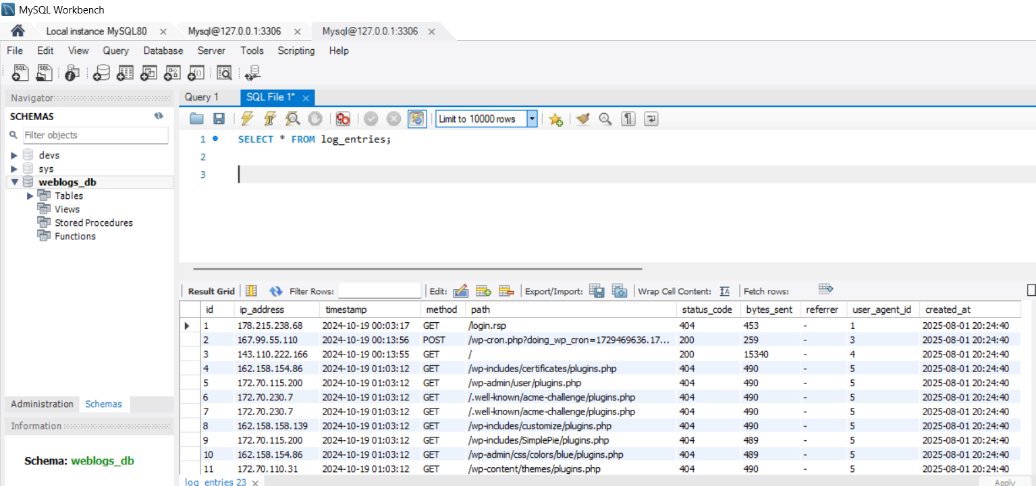
TECHNICAL SPECIFICATIONS
Log Format: Apache Common Log Format.
MySQL Tables:
log_entries (IP, timestamp, path, etc.).
user_agents (OS, browser, device type).
Indexes: Timestamp, IP, status code for fast queries.

Slide 8
CORE REQUIREMENTS
Ingest and parse large log files (Apache Common Log Format)
Use regex to extract structured data:
IP address, Timestamp, Method, URL, Status code, Bytes, User Agent
Transform and normalize data:
Convert types, separate user agents into their own table
Load data efficiently into MySQL
Use batch inserts, handle duplicates (idempotency)
Build a Command Line Interface (CLI) for:
Log processing
Traffic & error analysis reports
Implement error handling and performance optimization

Slide 9
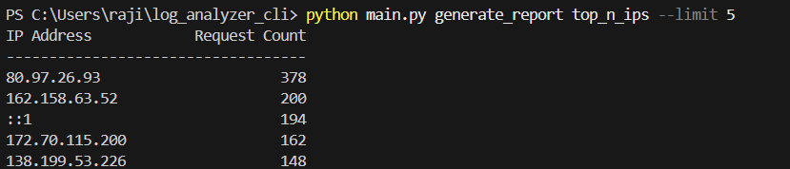
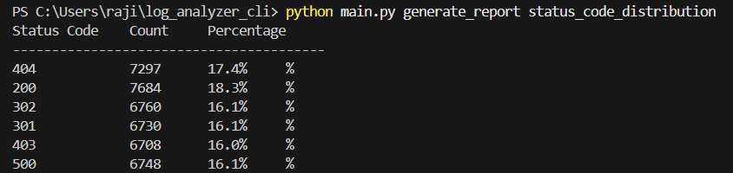
OUTPUT
generate_report top_n_ips --limit 5
generate_report status_code_distribution

Slide 10
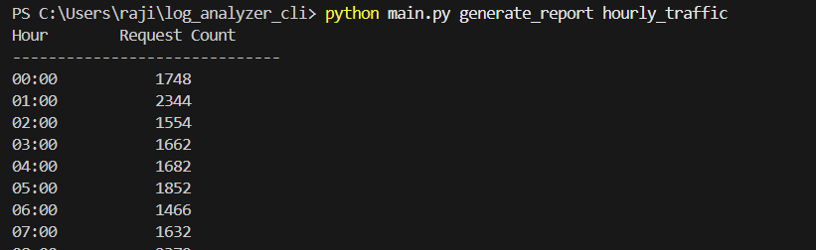
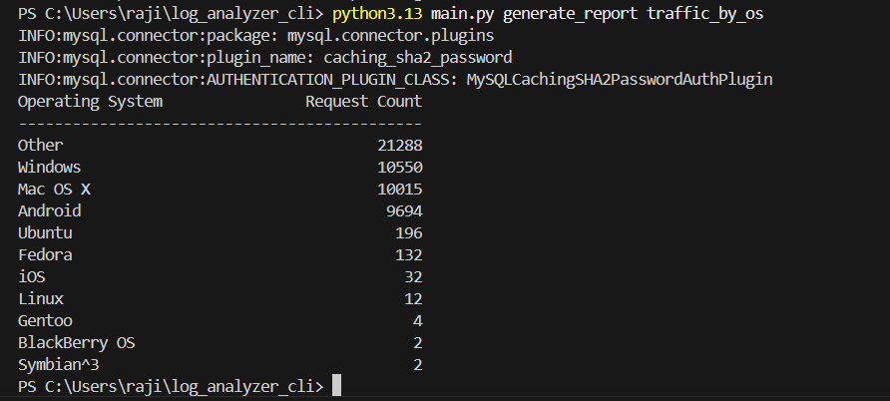
Generate_report hourly_traffic
Generate_report traffic_by_os
Generate hourly traffic

Slide 11
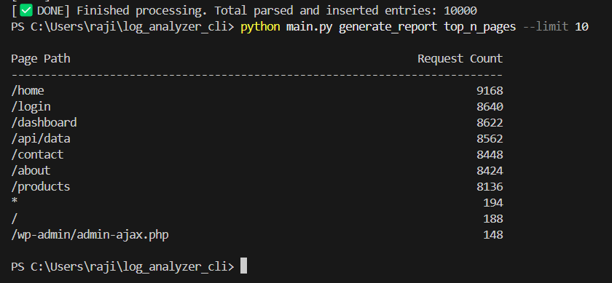
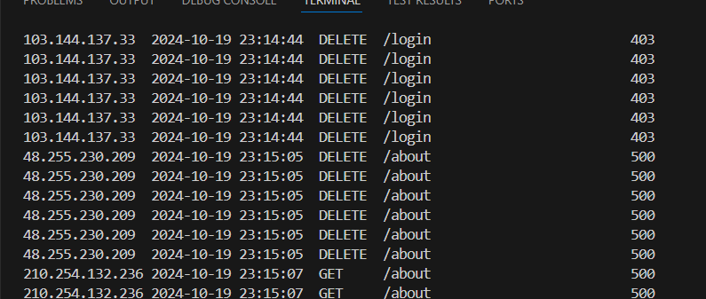
Generate_report top_n_pages
Generate_report error logs by date

